Slide 1
MINI PROJECT
TO DO LIST
SUBMITTED BY: SUBMITTED TO:
AVIRAL SINGH (I-2115000244) SUMAN KUMAR (TECHNICAL)
NIKHIL PANDEY (K-2115000669) (DEPARTMENT OF COMPUTER
ANUJ GUPTA (K-2115000174) ENGINEERING AND APPLICATION)
SHIVANSH KUMAR(N-2115000961)

Slide 2
INTRODUCTION
In today's fast-paced world, effective task management is crucial for personal and professional success. With the advent of technology, we now have the opportunity to streamline and enhance our daily productivity through digital solutions. The To-Do List Web Development Project aims to create a user-friendly and efficient online platform that empowers individuals and teams to organize, prioritize, and accomplish their tasks with ease.

Slide 3
PROJECT OVERVIEW
The To-Do List web application will be a dynamic and responsive platform accessible from various devices, ensuring users can manage their tasks anytime, anywhere. The application will offer features such as task creation, editing, categorization, prioritization, and completion tracking. Users will be able to register accounts, log in securely, and personalize their task lists to suit their unique workflow.

Slide 4
OBJECTIVE
The primary objectives of the To-Do List web development project revolve around creating a user-friendly and efficient platform for effective task management. The foremost goal is to design an intuitive interface that allows users to seamlessly create, edit, and organize their tasks, ensuring a straightforward user experience. The implementation of secure user authentication aims to provide a personalized environment, guaranteeing data privacy and individualized task lists. The ability to prioritize and categorize tasks addresses the diverse needs of users, aiding in the organization of responsibilities. A responsive design ensures accessibility across various devices, promoting usability and convenience. Real-time updates facilitate instantaneous synchronization of task lists, crucial for collaborative efforts and team-based projects. Incorporating reminders and notifications enhances user productivity by helping them stay informed about impending deadlines. The project also focuses on robust data persistence and security measures, ensuring reliable storage and protection of user data. Scalability is considered to accommodate a growing user base and increasing data volume. Comprehensive documentation and support channels are integral to providing users and developers with the necessary resources and assistance. Ultimately, these objectives collectively aim to deliver a powerful and adaptable To-Do List application that meets the dynamic demands of users in both personal and professional contexts.

Slide 5
PROBLEM STATEMENT
The To-Do List web development project seeks to address the challenges individuals and teams face in managing their tasks effectively. Currently, many users grapple with disorganized and inefficient task management systems, leading to missed deadlines, overlooked priorities, and a general lack of productivity. Traditional methods, such as handwritten lists or basic digital note-taking, often lack features necessary for modern workflows, such as real-time collaboration, reminders, and seamless cross-device accessibility. Additionally, the absence of secure user authentication in some existing solutions compromises data privacy. The need for a comprehensive, user-friendly, and feature-rich To-Do List application is evident, one that not only allows for the creation and organization of tasks but also integrates advanced functionalities to enhance task prioritization, categorization, and collaboration. The project aims to alleviate these pain points by providing a robust solution that promotes efficient task management, ensuring users can easily stay on top of their responsibilities and optimize their daily workflows.

Slide 6
POPULAR TO DO LIST PLATFORMS
Todolist:
Key Features: Task creation, due dates, labels, project organization, collaboration features, integrations with various apps.
Platforms: Web, mobile (iOS, Android), desktop (Windows, macOS).
Wunderlist (now part of Microsoft To Do):
Key Features: Task lists, due dates, reminders, file attachments, collaboration, sync across devices.
Platforms: Web, mobile (iOS, Android), desktop (Windows, macOS).
Microsoft To Do:
Key Features: Integration with Microsoft 365, task lists, due dates, reminders, file attachments.
Platforms: Web, mobile (iOS, Android), desktop (Windows, macOS).
Any.do:
Key Features: Task creation, due dates, reminders, collaboration, notes, file attachments.
Platforms: Web, mobile (iOS, Android), desktop (Windows, macOS).
Google Keep:
Key Features: Note-taking, checklist creation, collaboration, color coding, integration with Google services.
Platforms: Web, mobile (iOS, Android).

Slide 7
KEY FEATURES
User Authentication:
Objective: Secure user authentication to enable users to create accounts, log in securely, and access personalized task lists.
Rationale: User accounts enhance privacy and provide a personalized experience for task management.
Task Management:
Objective: Allow users to create, edit, and delete tasks, including details such as due dates, descriptions, and labels.
Rationale: Fundamental task management features empower users to organize their responsibilities effectively.
Prioritization and Categorization:
Objective: Enable users to prioritize tasks and categorize them based on different criteria.
Rationale: Prioritization and categorization enhance organization and help users focus on high-priority items.
Responsive Design:
Objective: Implement a responsive design to ensure a seamless and consistent user experience across various devices and screen sizes.
Rationale: Accessibility on different platforms promotes user engagement and usability.
Real-time Updates:
Objective: Implement real-time updates to reflect changes instantly, particularly in collaborative or team-based settings.
Rationale: Real-time synchronization ensures users have the most up-to-date information.

Slide 8
TARGET AUDIENCE
Individual Users:
Description: Individuals who want a personal task management tool to organize their daily activities, set goals, and keep track of deadlines.
Needs: User-friendly interface, personalization options, and features for prioritizing and categorizing tasks.
Students:
Description: Students looking for a tool to manage assignments, deadlines, and study schedules.
Needs: Task prioritization, reminders, collaboration features for group projects, and integration with academic calendars.
Professionals:
Description: Working professionals seeking a comprehensive tool to manage work tasks, projects, and deadlines.
Needs: Integration with professional tools (calendars, email), collaboration features for team projects, and advanced task tracking.
Teams and Collaborative Groups:
Description: Teams and groups within organizations requiring a centralized platform for collaborative task management.
Needs: Collaboration features, real-time updates, team-based task assignment, and shared project views.
Freelancers:
Description: Freelancers managing multiple projects and tasks for different clients.
Needs: Project-based organization, time tracking, invoicing features, and flexibility for managing varied tasks.

Slide 9
TECHNOLOGY STACK
Front-End:
HTML5/CSS3: Standard markup and styling languages for building the structure and presentation of web pages.
JavaScript (ES6+): The primary scripting language for creating dynamic and interactive user interfaces.
Front-End Framework/Library:
React.js or Vue.js: Modern JavaScript frameworks for building user interfaces. They provide a component-based architecture, making it easier to manage and update the application's UI.
Back-End:
Node.js (Express.js): A server-side JavaScript runtime that allows you to build scalable and fast server applications. Express.js is a popular web application framework for Node.js.
Database:
MongoDB (NoSQL): A document-oriented NoSQL database, suitable for flexible and scalable data storage. MongoDB can be advantageous for handling tasks and their associated data.
Authentication:
JSON Web Tokens (JWT): A standard for creating secure access tokens. It can be used for user authentication and authorization.

Slide 10
DEVELOPMENT PROCESS
Planning:
Define project objectives and scope.
Identify target audience and user needs.
Select an appropriate technology stack.
Design and Wireframing:
Create user flow and wireframes.
Develop UI/UX design based on wireframes.
Front-End Development:
Set up the project structure.
Build UI components using React.js or Vue.js.
Ensure responsive design for various devices.
Back-End Development:
Configure the server using Node.js.
Implement RESTful APIs for tasks and user authentication.
Set up real-time updates using Socket.io.
Authentication and Authorization:
Implement secure user registration and login.
Set up user roles and permissions.
Stay updated on security best practices.

Slide 11
CHALLENGES AND SOLUTIONS
Complex Task Relationships:
Challenge: Managing dependencies and relationships between tasks, especially in projects with intricate workflows.
Solution: Implement a comprehensive task hierarchy or dependency system to handle complex relationships and dependencies.
Real-Time Synchronization:
Challenge: Ensuring real-time updates across devices can be challenging, especially in collaborative environments.
Solution: Utilize technologies like WebSocket (e.g., Socket.io) to enable real-time communication and synchronization between clients and the server.
Security Concerns:
Challenge: Protecting user data and ensuring secure authentication.
Solution: Implement HTTPS for secure data transmission, use strong encryption methods, and follow best practices for user authentication (e.g., JWT).
Scalability:
Challenge: Handling an increasing number of users and tasks while maintaining performance.
Solution: Design the application with scalability in mind, use a scalable database, and consider load balancing strategies.
User Authentication and Authorization:
Challenge: Managing user authentication securely and implementing role-based access control.
Solution: Use established authentication protocols (e.g., OAuth, OpenID) and set up proper authorization mechanisms to control access levels.

Slide 12
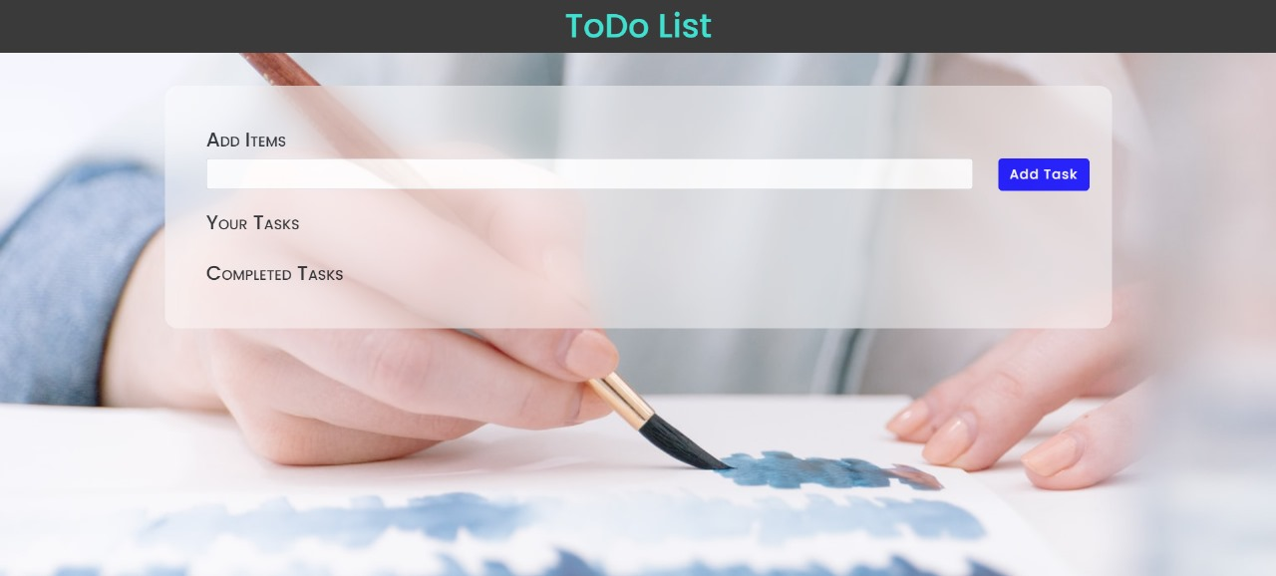
USER INTERFACE DESIGN

Slide 13
FUTURE ENHANCEMENTS
Smart Task Suggestions:
Description: Implement machine learning algorithms to analyze user behavior and suggest tasks based on historical data and patterns.
Voice Commands and Dictation:
Description: Integrate voice recognition capabilities for users to add, edit, or complete tasks using voice commands.
Advanced Filtering and Sorting:
Description: Enhance task organization with advanced filtering options, allowing users to sort tasks by various criteria, such as priority, due date, or project.
Natural Language Processing (NLP):
Description: Enable users to input tasks using natural language, and the application interprets and categorizes them accordingly.
Task Dependencies and Sequencing:
Description: Allow users to set dependencies between tasks, creating sequences that must be completed in a specific order.

Slide 14
CONCLUSION
In conclusion, the To-Do List web development project represents a comprehensive solution to the challenges individuals and teams face in managing tasks effectively. By combining robust task management features, real-time collaboration, and a user-friendly interface, the application aims to streamline the organization of responsibilities, boost productivity, and enhance overall efficiency. The project's objectives of providing a secure, scalable, and intuitive platform for task management have been met through careful planning, thoughtful design, and the implementation of advanced technologies. As users benefit from features such as smart task suggestions, voice commands, and collaborative project boards, the To-Do List application becomes a versatile tool adaptable to diverse user needs. With continuous improvement and a commitment to user feedback, the project stands as a testament to the dynamic nature of web development, where innovation meets the evolving demands of an ever-changing digital landscape.

Slide 15
THANKYOU

